Slide 1

Customer Goods Insights Analysis

Slide 2
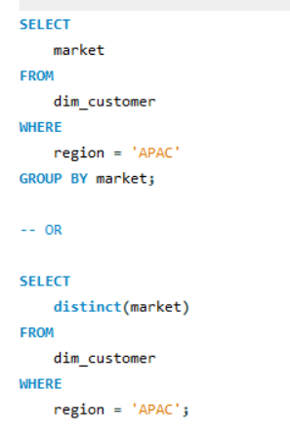
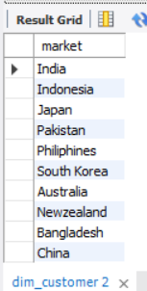
Question 1:- Provide the list of markets in which customer "Atliq Exclusive" operates its business in the APAC region.
Query-
Output result-

Slide 3
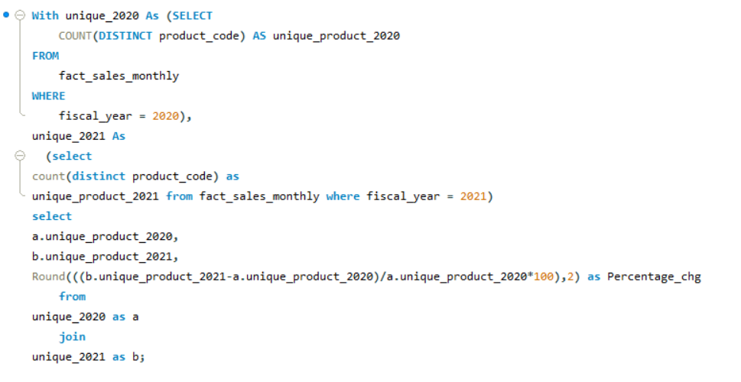
Question 2-: What is the percentage of unique product increase in 2021 vs. 2020? The final output contains these fields;unique_products_2020,unique_products_2021,percentage_chg.
Query-:

Slide 4
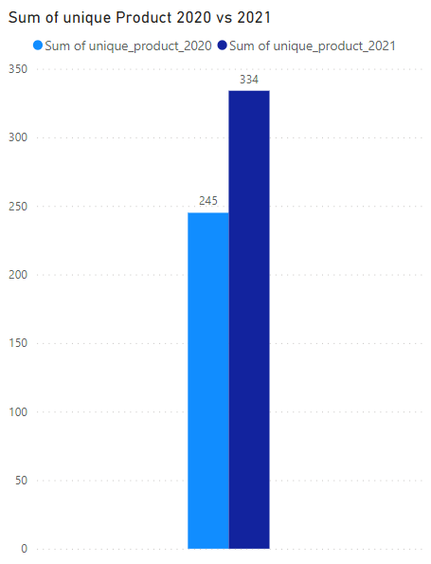
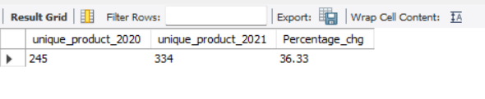
Output-
Visual

Slide 5
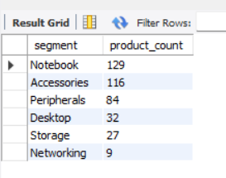
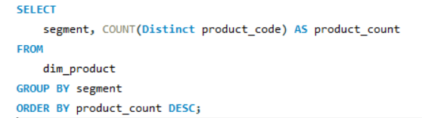
Question 3-: Provide a report with all the unique product counts for each segment and sort them in descending order of product counts. The final output contains2 fields; segment, product count
Query-
Output-

Slide 6
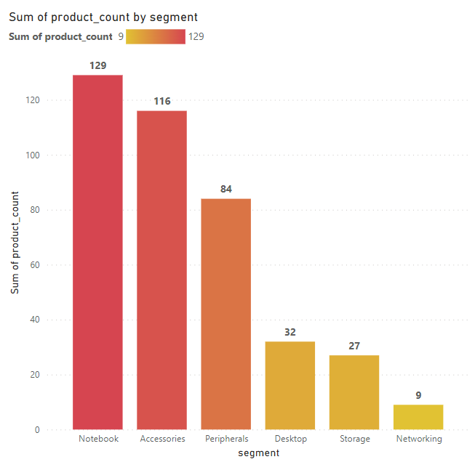
Visual

Slide 7
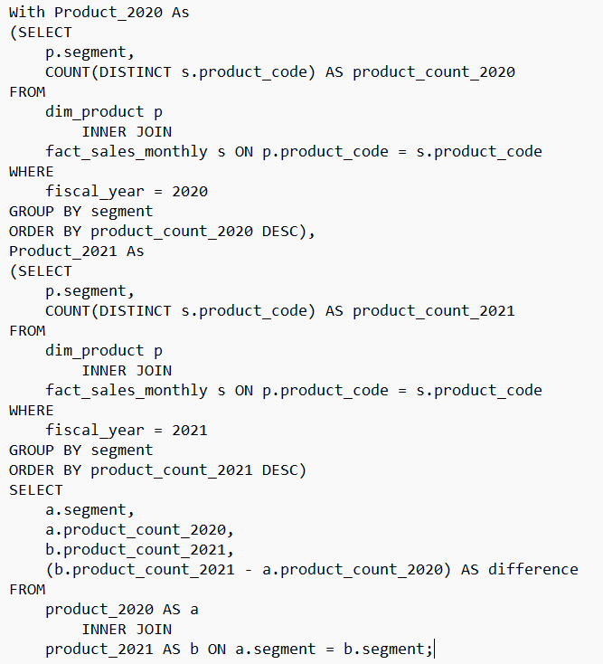
Question 4-: Which segment had the most increase in unique products in 2021 vs 2020?
Query-:

Slide 8
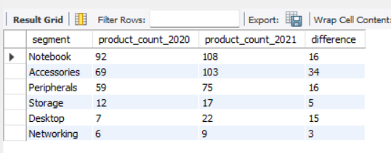
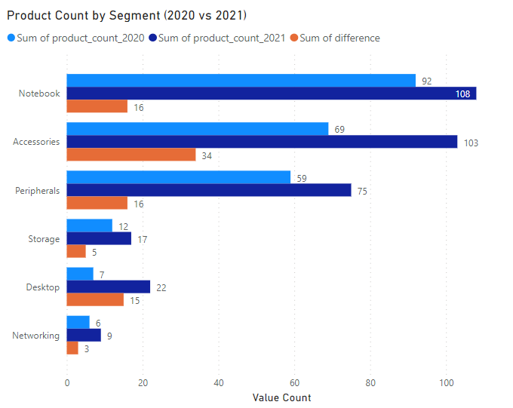
Output-
Visual

Slide 9
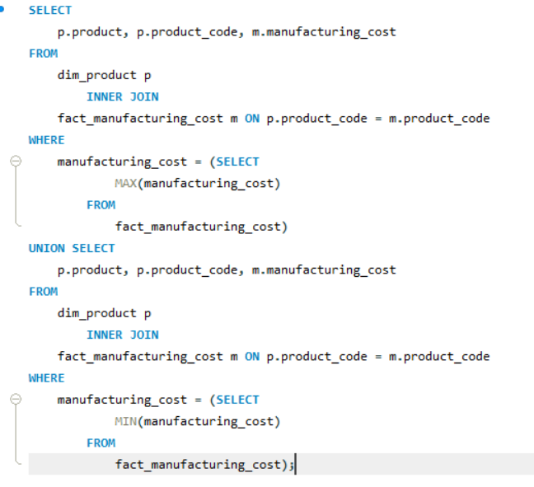
Question 5-: Get the products that have the highest and lowest manufacturing costs.
Query-:

Slide 10
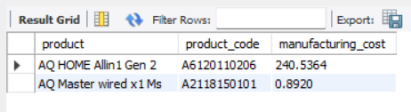
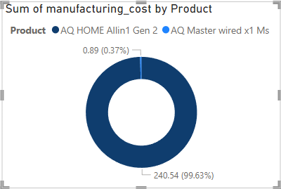
Output-
Visual

Slide 11
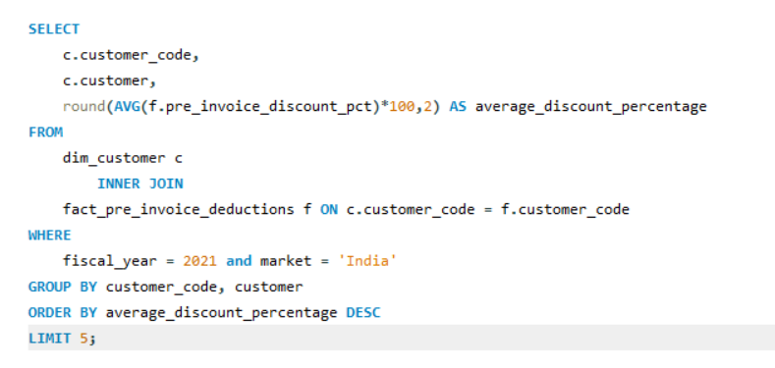
Question 6-:Generate a report which contains the top 5 customers who received an average high pre_invoice_discount_pct for the fiscal year 2021 and in the Indian market. The final output contains these fields customer_code,customer, average_discount_percentage .
Query-:

Slide 12
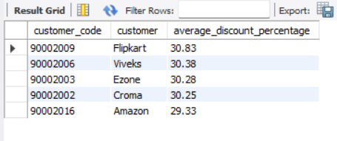
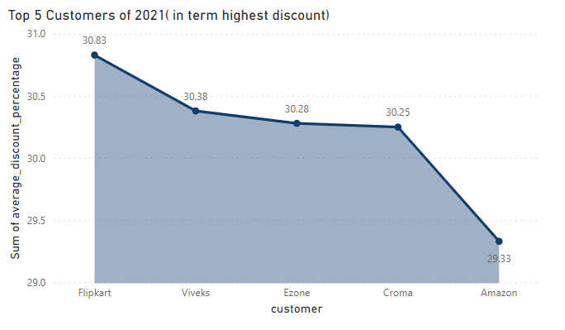
Output
Visual

Slide 13
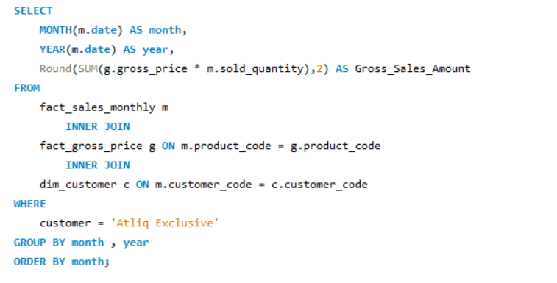
Question 7-: Get the complete report of the Gross sales amount for the customer “Atliq Exclusive” for each month. This analysis helps to get an idea of low and high-performing months and take strategic decisions. The final report contains these columns: Month, Year, Gross sales Amount.
Query-:

Slide 14
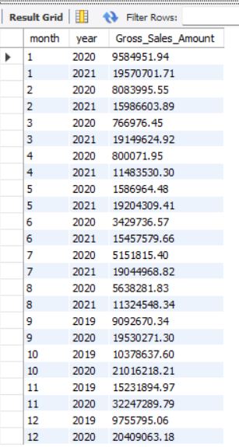
Query Output

Slide 15
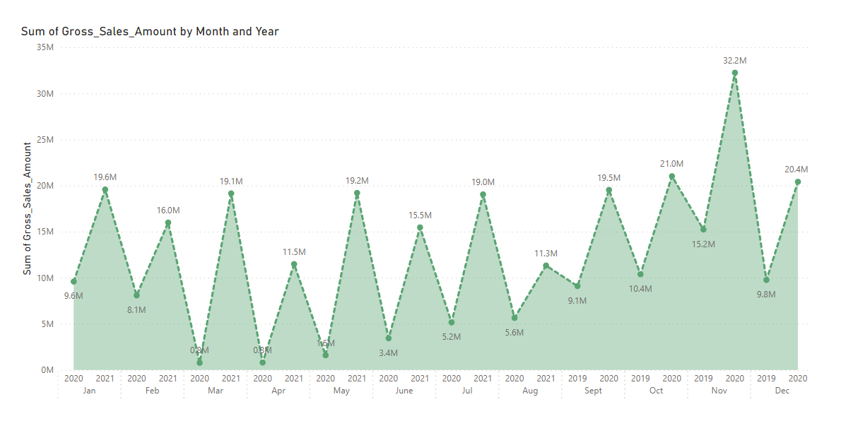
Visualization

Slide 16
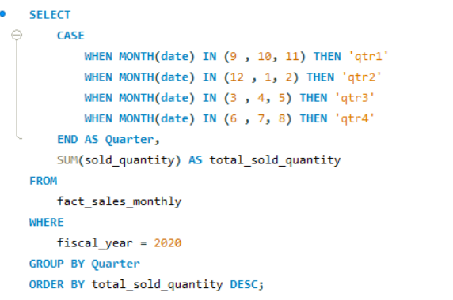
Question 8-: In which quarter of 2020, got the maximum total_sold_quantity? The final output contains these fields sorted by the total_sold_quantity, Quarter, total_sold_quantity(case statement)
Query-:

Slide 17
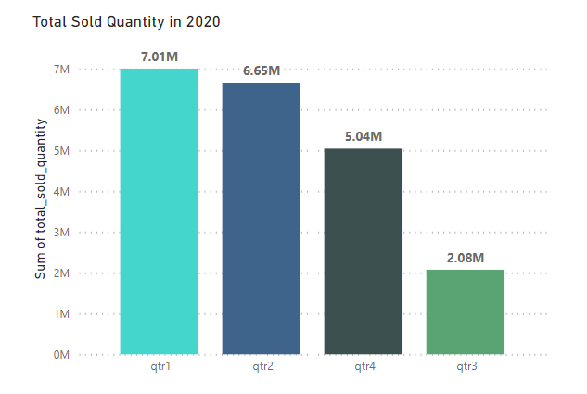
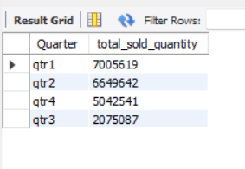
Output
Visual

Slide 18
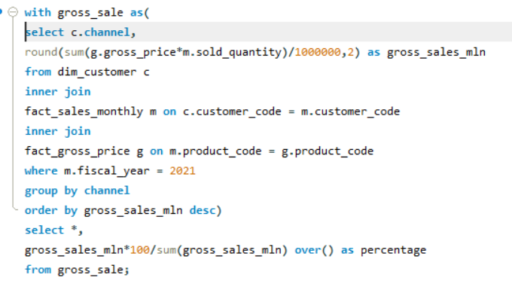
Question 9-:Which channel helped to bring more gross sales in the fiscal year 2021 and the percentage of contribution? The final output contains these fields, channel, gross_sales_mlnpercentage
Query-:

Slide 19
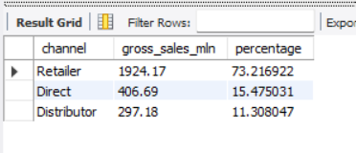
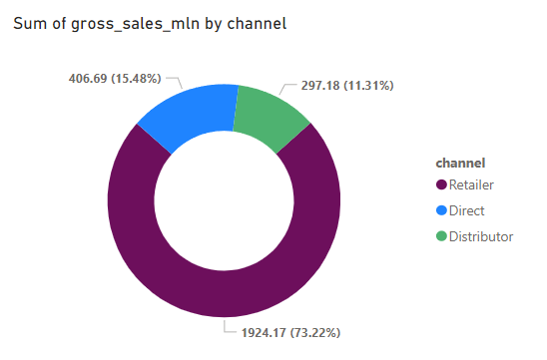
Output-:
Visual

Slide 20
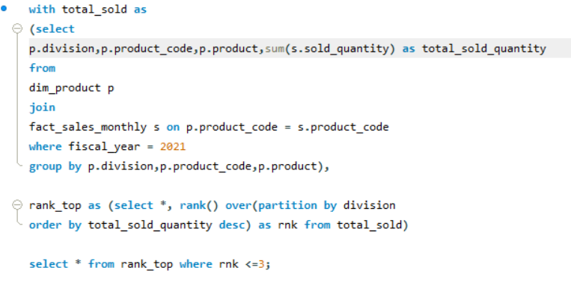
Question 10-: Get the Top 3 products in each division that have a high total_sold_quantity in the fiscal_year 2021? The final output contains these fields, division, product_code, product, total_sold_quantity, rank_order.
Query-:

Slide 21
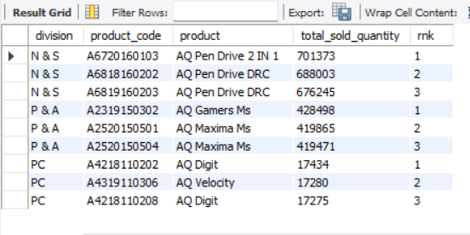
Output

Slide 22
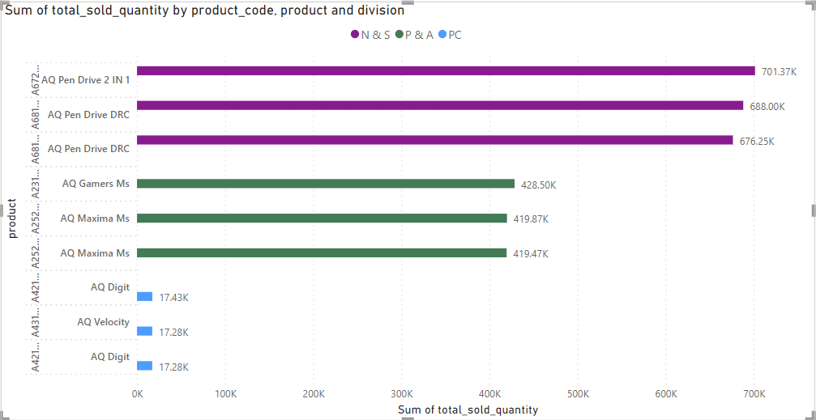
Visualization

Slide 23
Insights Summary
In Request 1 The list of markets in which customer "Atliq Exclusive" operates its business in the APAC region are:- India, Indonesia, Japan, Philippines, South Korea, Australia, New Zealand, Bangladesh.
Insights of request 2 on basis of Unique product are……..
❑Total 245 Unique Products their in 2020 and 334 Unique Products are their in 2021
❑No. of new Products added in 2021 are 89 , As per percentage 2021 36.33 percent more than year 2020
In request 3 we found the insights of unique product over different segments,
❑We found that segment Notebook have highest count with 129 Unique product and Networking have low count with 9 unique products
❑Peripherals and Desktop are at settle at middle with the unique product count 84 and 32

Slide 24
Insights of request 4 on basis of Segments over unique product in 2020 and 2021 years are……..
❑We found the Accessories have highest difference in Unique Product Code compare to previous year with the difference of 34
❑Networking have the lowest difference compare to previous year.
In request 5 we found out the Highest and Lowest Manufacturing of Products
❑AQ HOME Allin 1 Gen 2 Product have the highest Manufacturing cost value 240.54 and Product code ‘A6120110206’
❑AQ Master Wired x 1 MS Product have the lowest Manufacturing cost value 0.89 and Product code ‘A2118150101’.
Insights of request 6 on basis of Customer who received highest average Pre invoice discount percentage in 2021
❑ Filpkart have received the highest average pre invoice discount of 0.3803 , Followed by Viveks, Ezone, Crome and Amazon.

Slide 25
In request 7 we found Gross sales amount of Atliq Exclisive Customer over different Months
❑Highest Gross sales are occurs in the Month of November in 2020 and gross sales amount value 32.24 Millions
❑Lowest Gross sales are occurs in the Month of March in 2020 and gross sales amount value 0.76 Millions.
Insights of request 8 on the Quarter which have highest Total sold Quantity in year 2020……..
❑Quarter 1 have the highest total sold quantity value 7.01 Millions ❑Quarter 3 have the lowest total sold quantity value 2.07 Million.
In request 9 we found out Channel which have highest gross sales in the fiscal year 2021
❑Retailers have the highest gross sales percentage of 73.22%
❑Direct channel have gross sales percentage of 15.48%
❑Distributor channel have gross sales percentage of 11.30%.

Slide 26
Request 10, We have to drawn the insights of Top 3 Products in each division that have highest sold quantity in the fiscal year 2021
❑The Product AQ Pen Drive 2 IN 1 Ranks Top in N & S Division with value 0.70 Millions and the Product Code ‘A6720160103’
❑The Product AQ Gamers Ms Ranks Top in P & A Division with value 0.42 Millions and the Product Code ‘A2319150302’
❑The Product AQ Digit Ranks Top in PC Division with value 0.017 Millions and the Product Code ‘A4218110202’.

